Slide 1
Lecture-17

Slide 2
Encoder
Encoding is the converse of decoding.
Given a set of input lines, where one has been selected, provide a code corresponding to that line.
Contains 2^{n} (or fewer) input lines and n output lines.
Implemented with OR gates.
An example:
F₀
D₀
Select via switches
F₁
4-to-2 Encoder
F₂
2-bits code
F₃
D₁

Slide 3
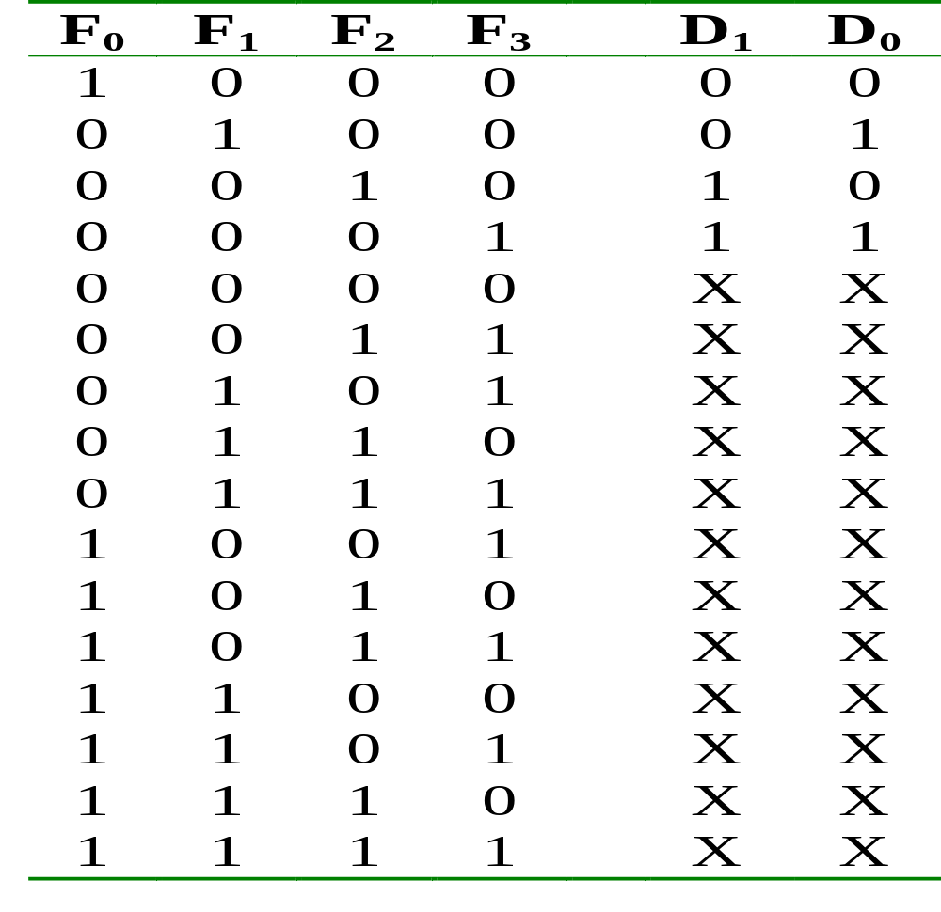
Encoder
Truth table:

Slide 4
Encoder
With the help of K-map (and don’t care conditions), can obtain:
D₀ = F1 + F3
D₁ = F2 + F3
which correspond to circuit:
F₀
F₁
D₀
Simple 4-to-2 encoder
F₂
F₃
D₁

Slide 5
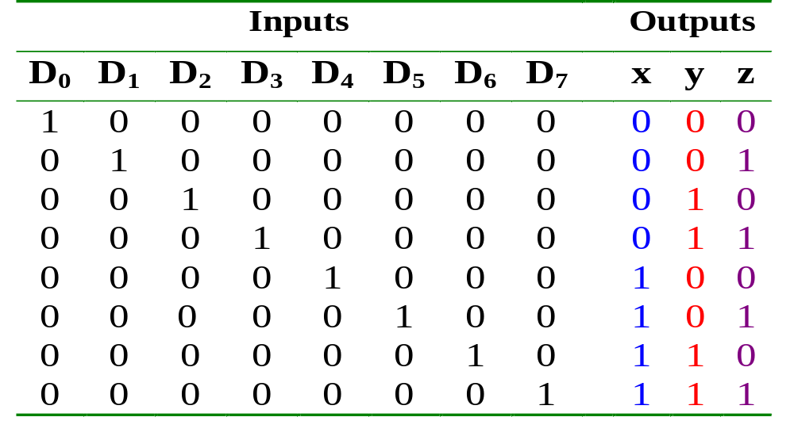
Encoder
Example: Octal-to-binary encoder.
  At any one time, only one input line has a value of 1.

Slide 6
Encoder
Example: Octal-to-binary encoder.
D₀
D₁
D₂
D₃
D₄
D₅
D₆
D₇
x = D₄ + D₅ + D₆ + D₇
y = D₂ + D₃ + D₆ + D₇
z = D₁ + D₃ + D₅ + D₇
Exercise: Can you design a 2^{n}-to-n encoder without the K-map?

Slide 7
Priority Encoders
Solves the ambiguities mentioned above.
Multiple asserted inputs are allowed; one has priority over all others.
Separate indication of no asserted inputs.
PJF - <number>

Slide 8
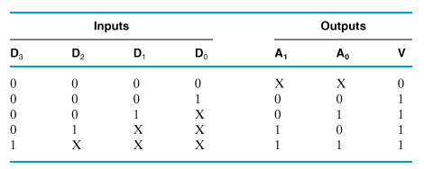
Example: 4-to-2 Priority Encoder
Truth Table
PJF - <number>

Slide 9
4-to-2 Priority Encoder (cont.)
The operation of the priority encoder is such that:
If two or more inputs are equal to 1 at the same time, the input in the highest-numbered position will take precedence.
A valid output indicator, designated by V, is set to 1 only when one or more inputs are equal to 1. V = D₃ + D₂ + D₁ + D₀ by inspection.
PJF - <number>

Slide 10
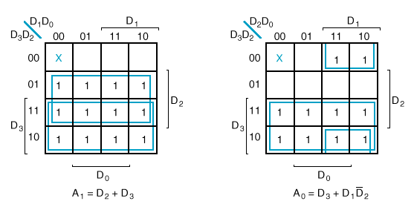
Example: 4-to-2 Priority Encoder
K-Maps
PJF - <number>

Slide 11
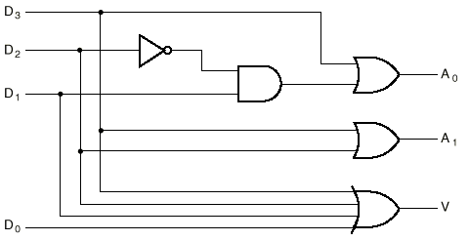
Example: 4-to-2 Priority Encoder
Logic Diagram
PJF - <number>

Slide 12
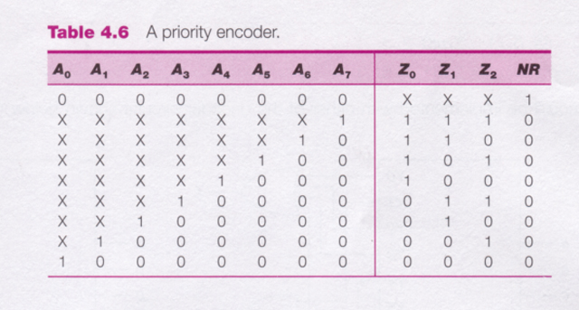
8-to-3 Priority Encoder
PJF - <number>

Slide 13
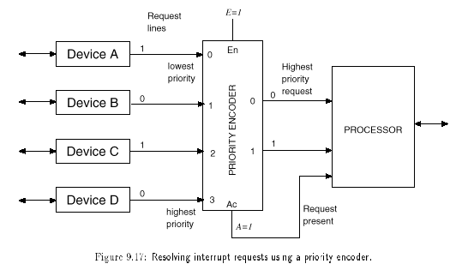
Uses of priority encoders (cont.)
PJF - <number>

Slide 14
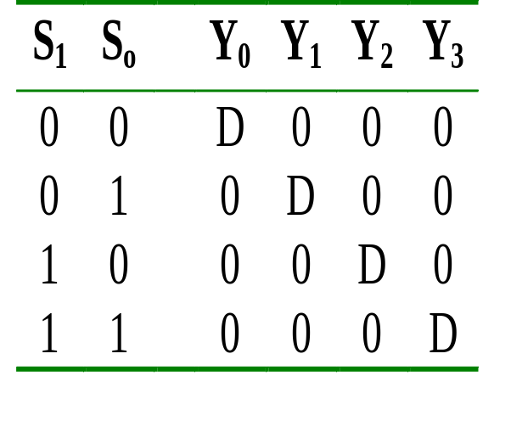
Demultiplexer
Given an input line and a set of selection lines, the demultiplexer will direct data from input to a selected output line.
An example of a 1-to-4 demultiplexer:
Outputs
Y₀ = D.S₁'.S₀'
Y₁ = D.S₁'.S₀
Data D
demux
Y₂ = D.S₁.S₀'
Y₃ = D.S₁.S₀
S₁ S₀
select

Slide 15
Demultiplexer
The demultiplexer is actually identical to a decoder with enable, as illustrated below:
Y₀ = D.S₁'.S₀'
2x4 Decoder
S₁
S₀
Y₁ = D.S₁'.S₀
Y₂ = D.S₁.S₀'
E
Y₃ = D.S₁.S₀
D
Exercise: Provide the truth table for above demultiplexer.

Slide 16
Comparators
A comparator compares two n-bit values to determine which is greater, or if they are equal.

Slide 17
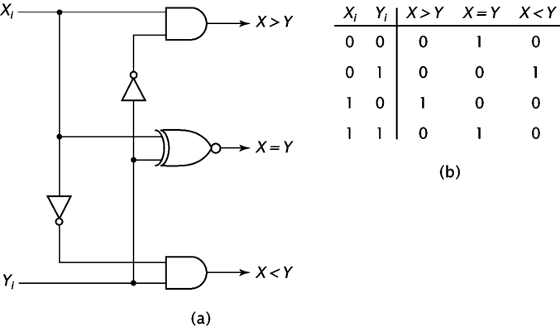
1-bit Comparator

Slide 18
Extending to Multibit Numbers
Compare the most significant bits.
  If they are not equal, no need to compare the other bits.
  If they are equal, we must check the next bit.
Continue until one number if found to be greater than the other, or all bits are checked and the numbers are found equal.

Slide 19
Arithmetic Circuits: Comparator
Magnitude comparator: compares 2 values A and B, to see if A>B, A=B or A<B.
Classical method requires 2^{2n} rows in truth table!
How do we compare two 4-bit values A (a₃a₂a₁a₀) and B (b₃b₂b₁b₀)?
If (a₃ > b₃) then A > B
If (a₃ < b₃) then A < B
If (a₃ = b₃) then if (a₂ > b₂) ….

Slide 20
Arithmetic Circuits: Comparator
Let A = A₃A₂A₁A₀ , B = B₃B₂B₁B₀; x_{i} = A_{i}.B_{i} + A_{i}'.B_{i}'
A₃
x₃
A₃'.B₃
B₃
A₃.B₃'
A₃'.B₃ + x₃.A₂'.B₂
+ x₃.x₂.A₁'.B₁
+ x₃. x₂.x₁.A₀'.B₀
A₂
x₂
B₂
(A < B)
A₁
x₁
B₁
A₃.B₃' + x₃.A₂.B₂'
+ x₃.x₂.A₁.B₁'
+ x₃. x₂.x₁.A₀.B₀'
A₀
x₀
(A > B)
B₀
(A = B)
x₃. x₂.x₁.x₀

Slide 21
Arithmetic Circuits: Comparator
0
1
1
0
A₃
A₂
A₁
A₀
4-bit comp
1
0
1
0
B₃
B₂
B₁
B₀
(A < B)
1
0
0
(A > B)
(A = B)
Block diagram of a 4-bit magnitude comparator

Slide 22
Sequential Logic
Combinational Logic
Output depends only on current input
Sequential Logic
Output depends not only on current input but also on past input values
Need some type of memory to remember the past input values

Slide 23
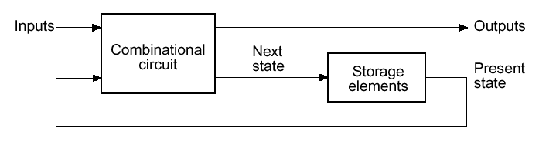
Circuits that we
have learned
so far
Information Storing
Circuits
Timed “States”

Slide 24
Types of Sequential Ckt.
Sequential ckt. can be classified into two types
  Synchronous
  Asynchronous

Slide 25
Synchronous sequential Circuit
A system whose behavior can be defined from the knowledge of its signal at discrete instant of time.
Practical Synchronous sequential logic system use fixed amplitudes such as voltage levels for the binary signals.
Synchronization is achieved by a timing device called a master clock generator.

Slide 26
Asynchronous sequential circuits
In this Behavior of sequential circuits depends upon the order in which its input signals change and can be affected at any instant of time.
In this type of ckt. Master clock generator is general not required.

Slide 27
Flip-Flop
A flip-flop circuit can maintain a binary state indefinitely(as long as power is delivered to the circuit) until directed by an input signal to switch states.
There are different type of flip flop based on number of input and in the manner in which the input affect the binary state.

